Slide 1
Sylvan Grove
APS HGR Gathering on Wed 4th May 2022 to honour
former members Hugh Stacy, Kyrill Taylor & Graham and Margaret Walters
in the presence of their families and friends.
We planted a tree for each family
And celebrated our change of name from East Hills Group (EHG)
To Harbour Georges River Group (HGR)

Slide 2
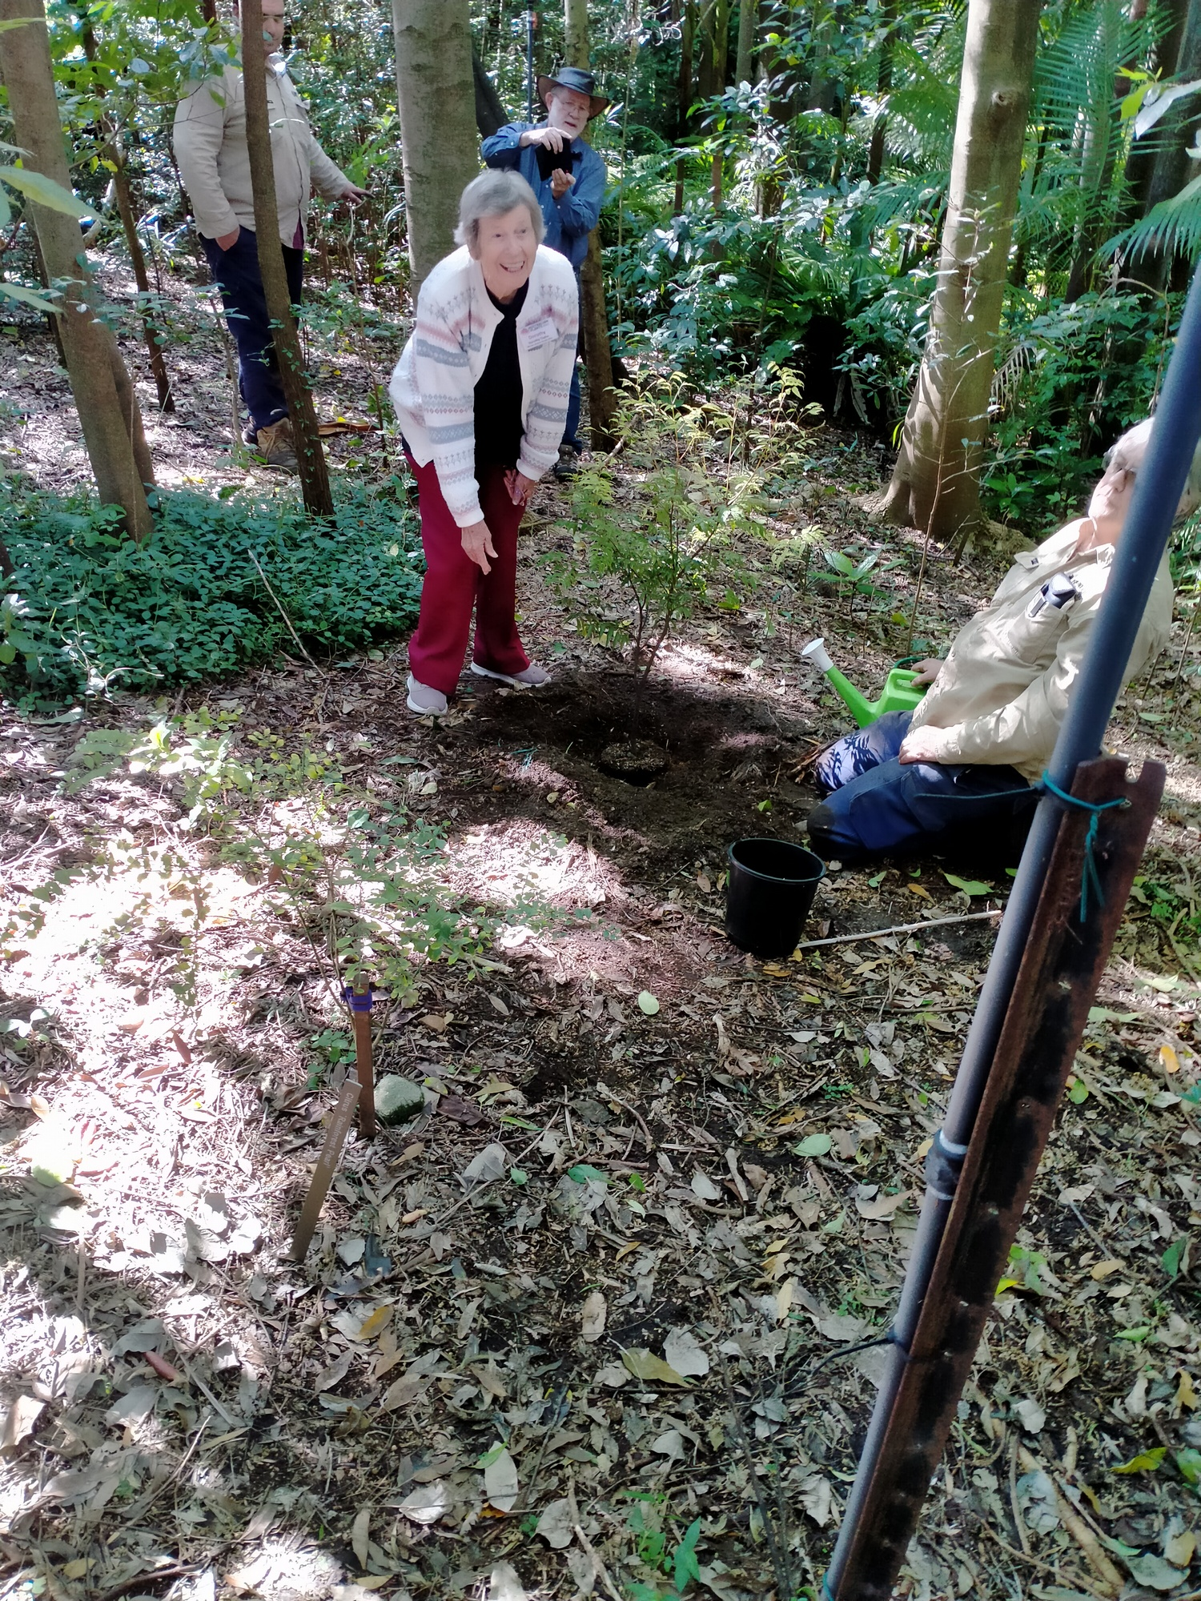
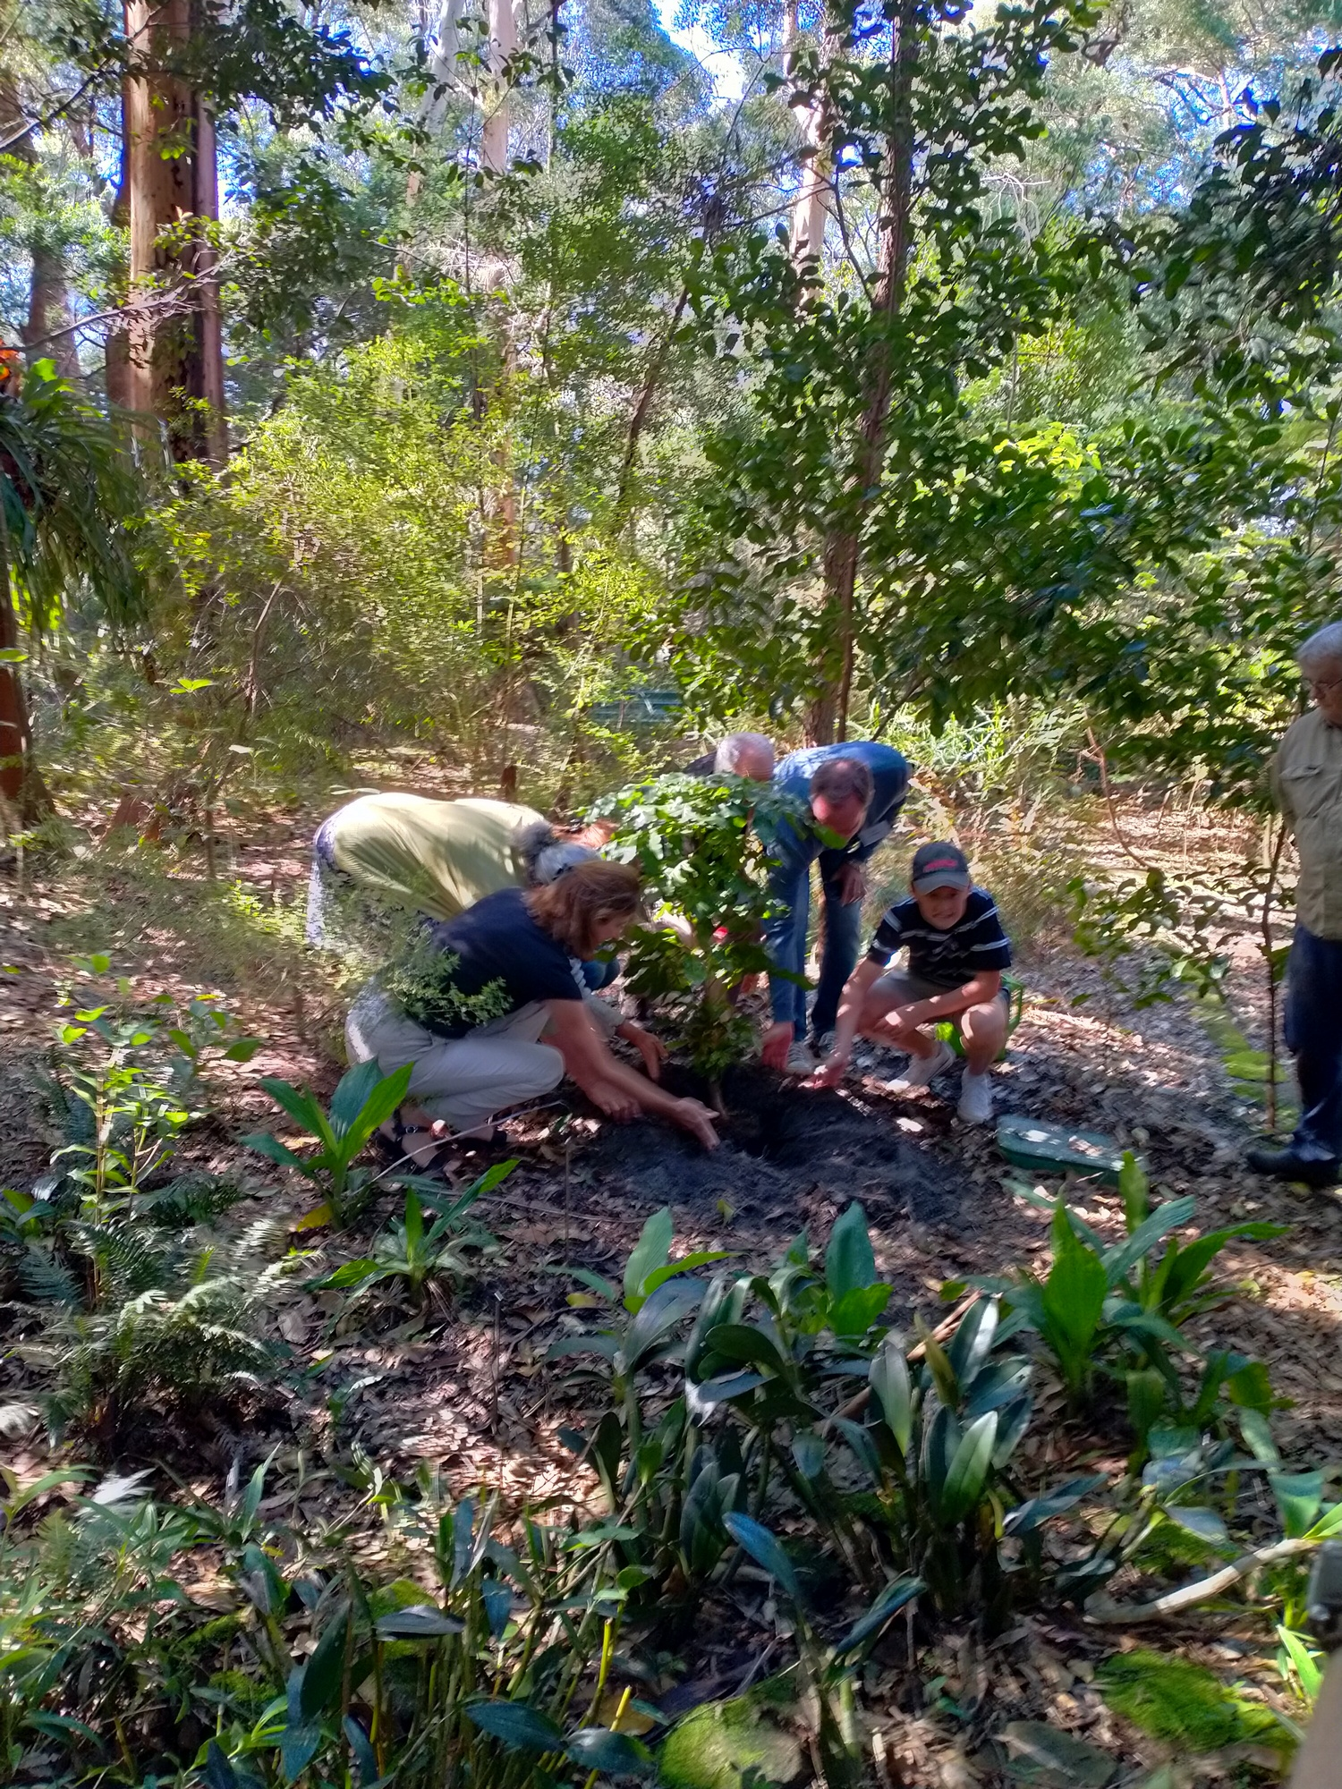
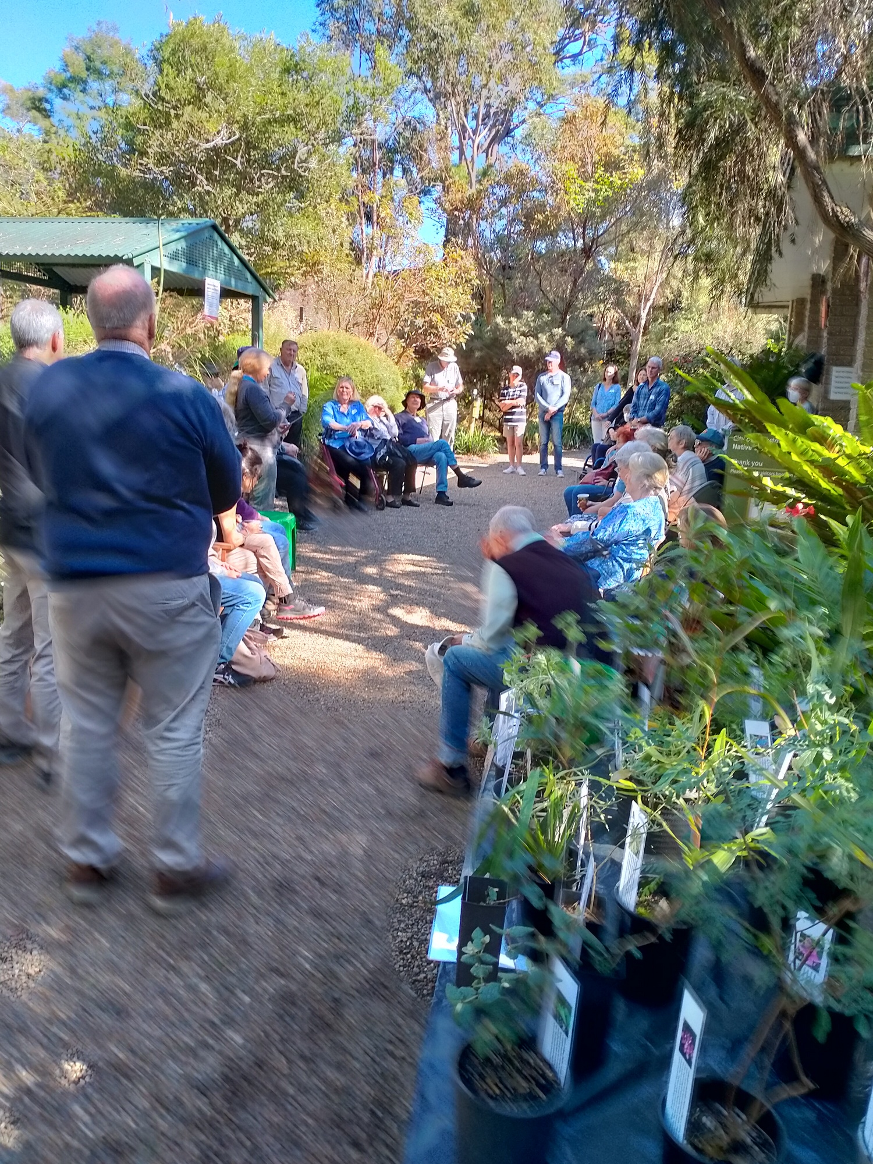
Walters Family
Speeches
Dorothy Taylor
Photos from Graham

Slide 3
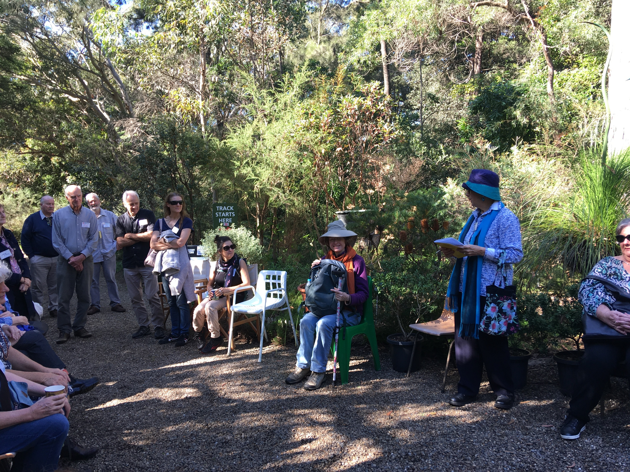
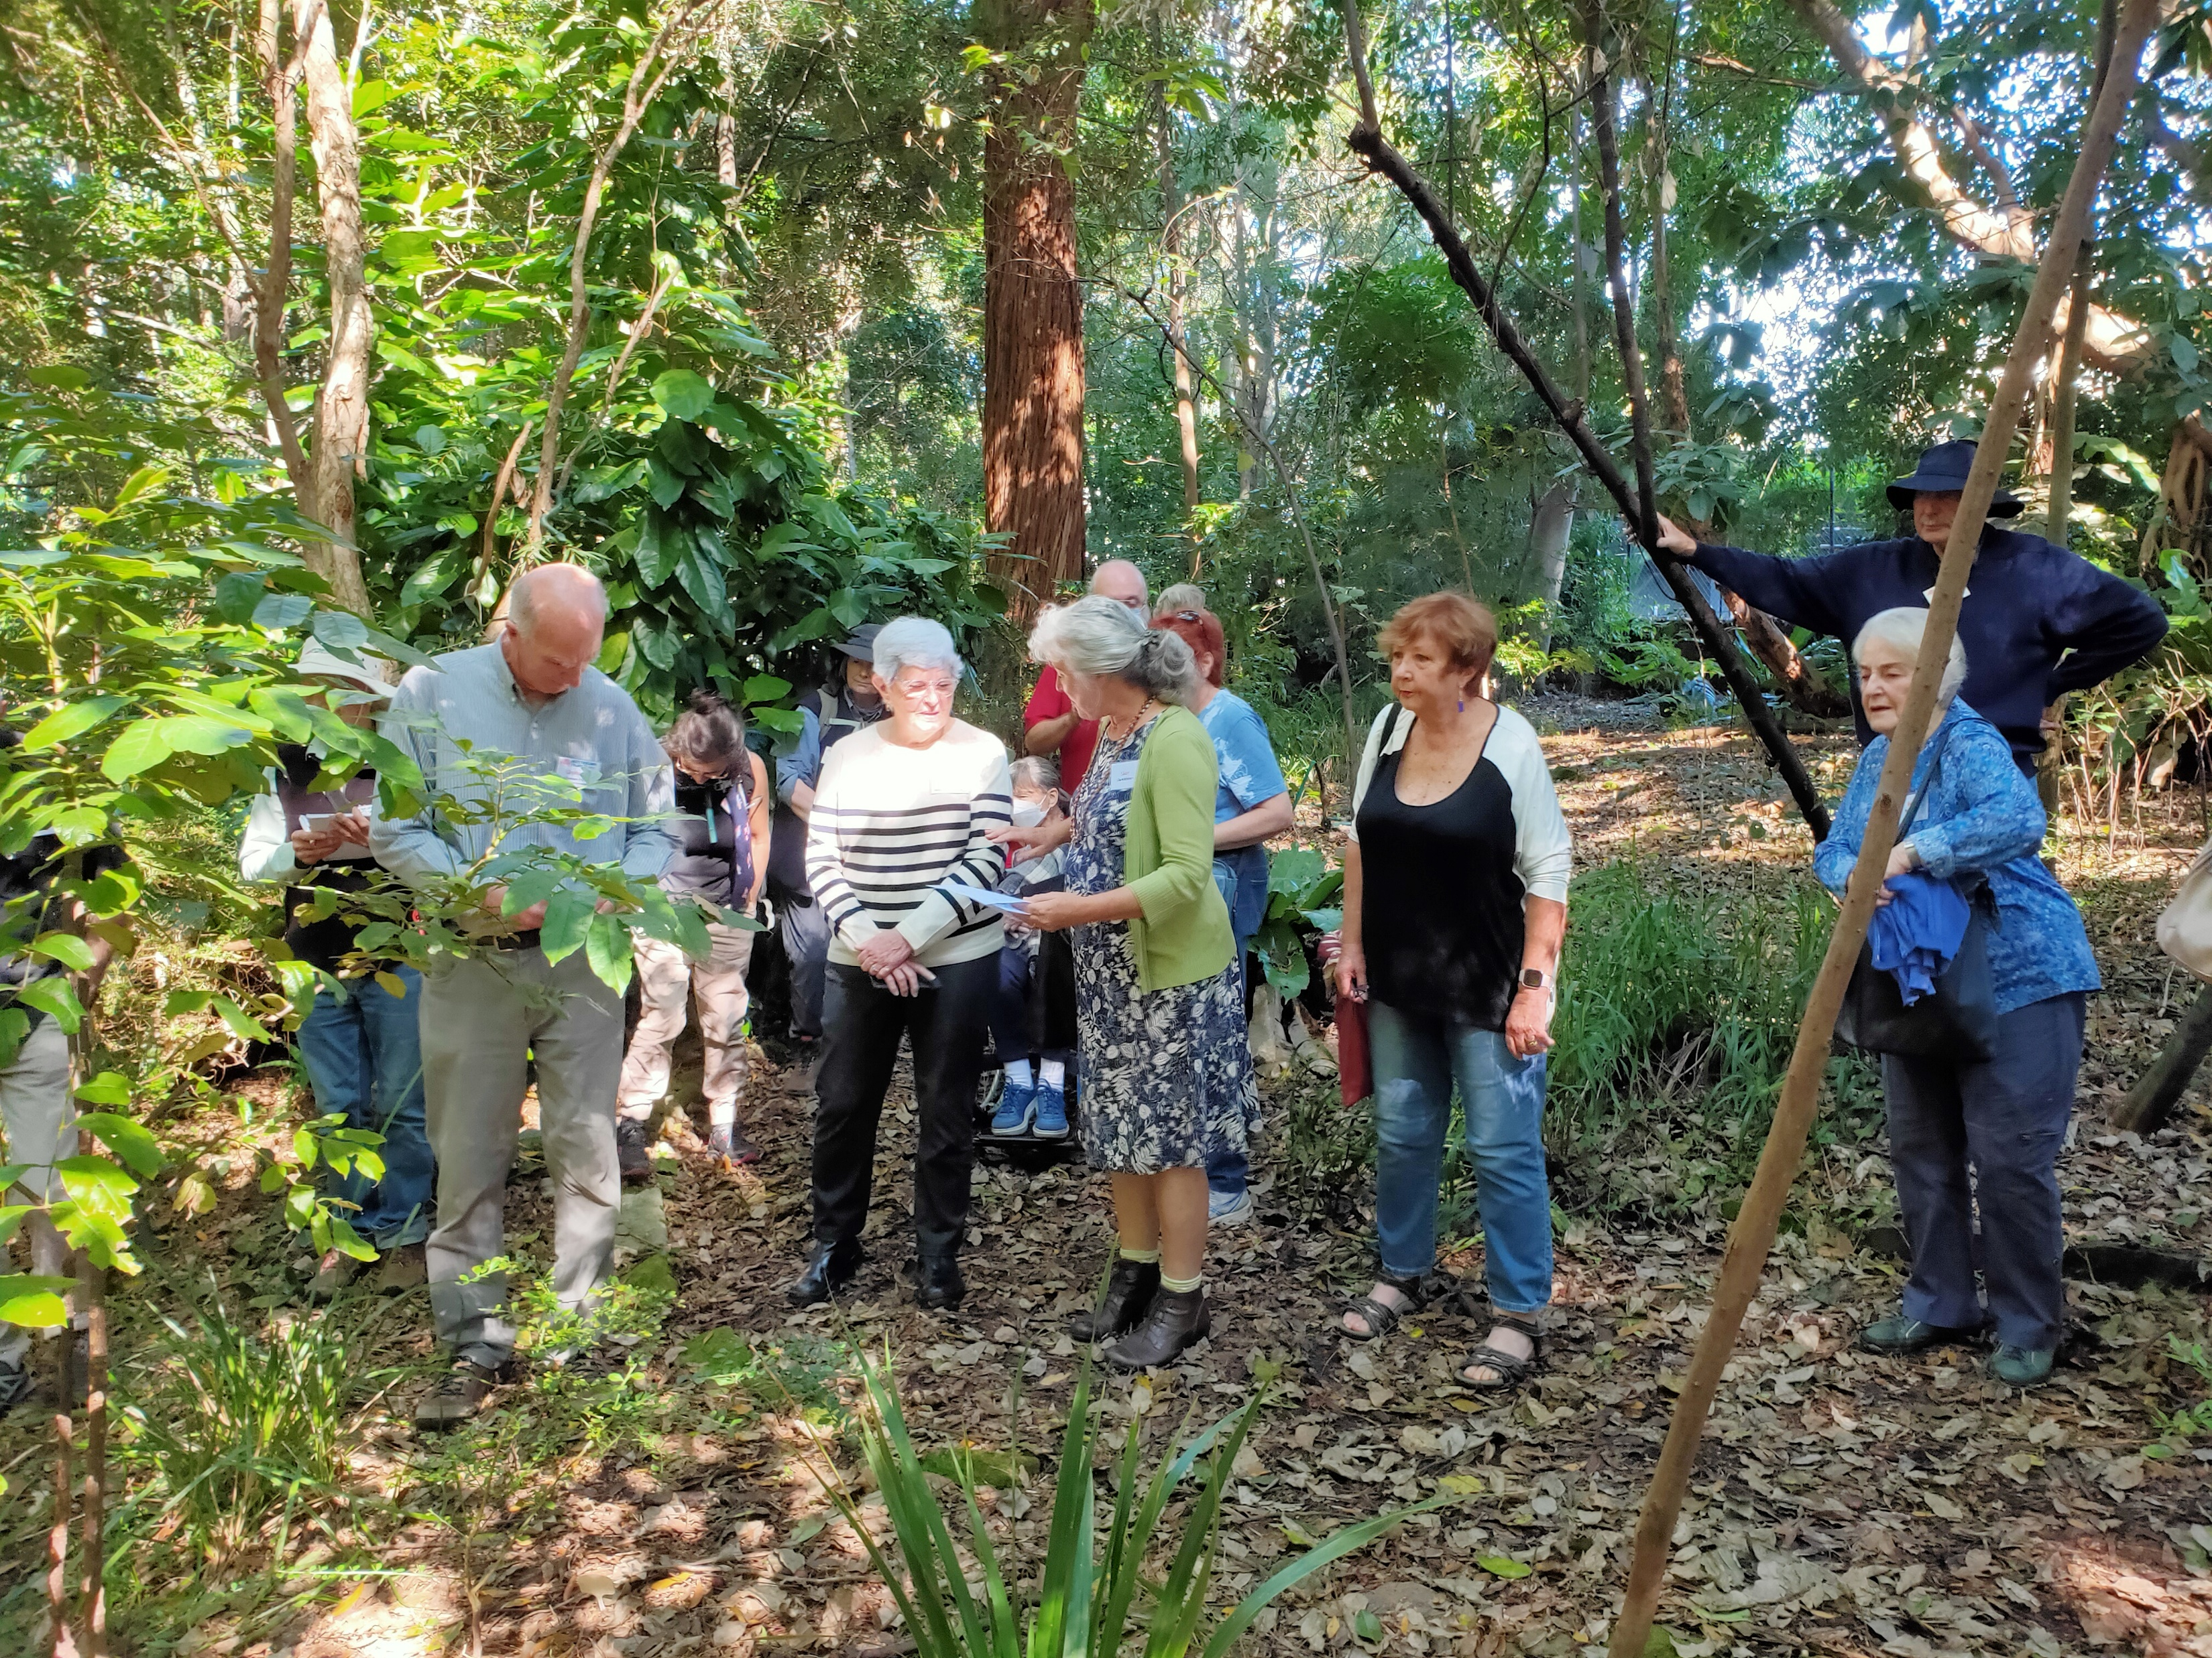
Left photo from Jan.
John, Graham, Dave,
Rob Walters, Sarah Walters,
Ana, Chris, Marie, Leonie
Right: photo from John Aitken.
Graham, Ana, Carol Drew, Sue Walters, Liz Aitken, Beverley Stacy, Tony Porritt behind

Slide 4
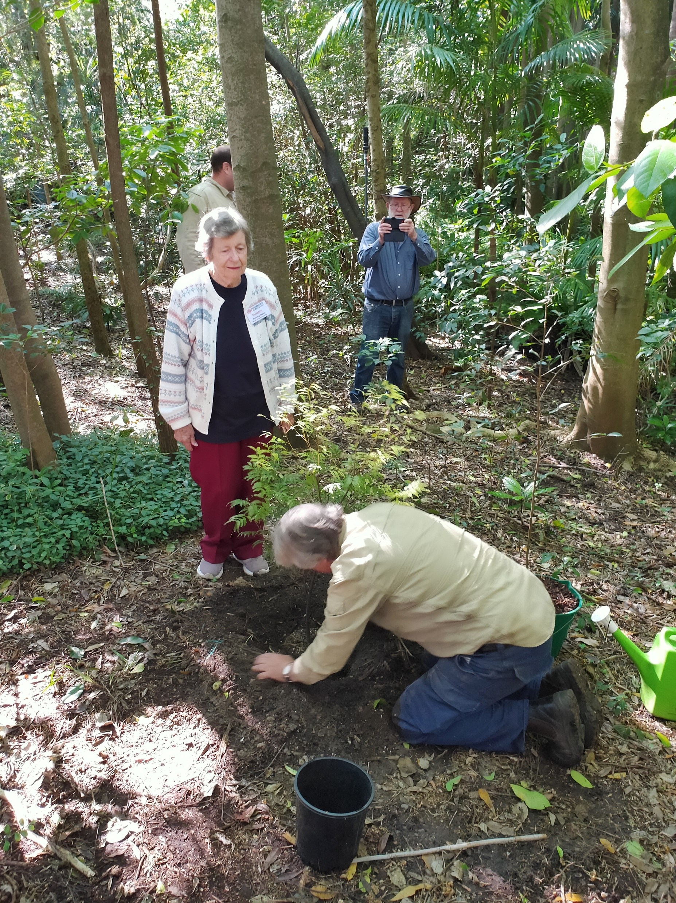
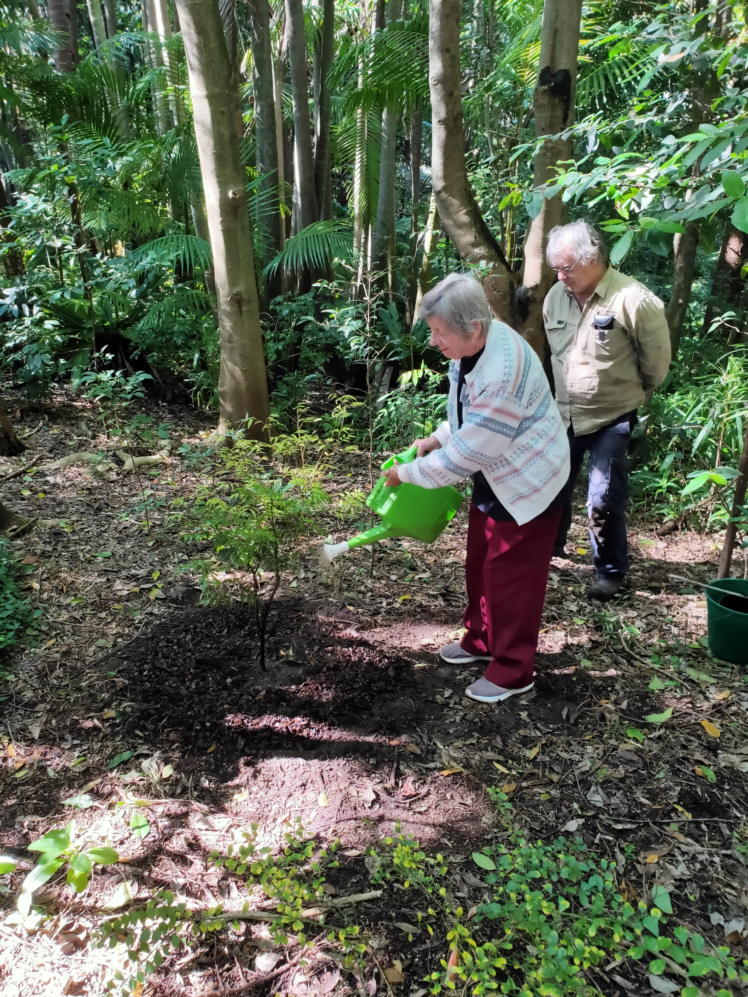
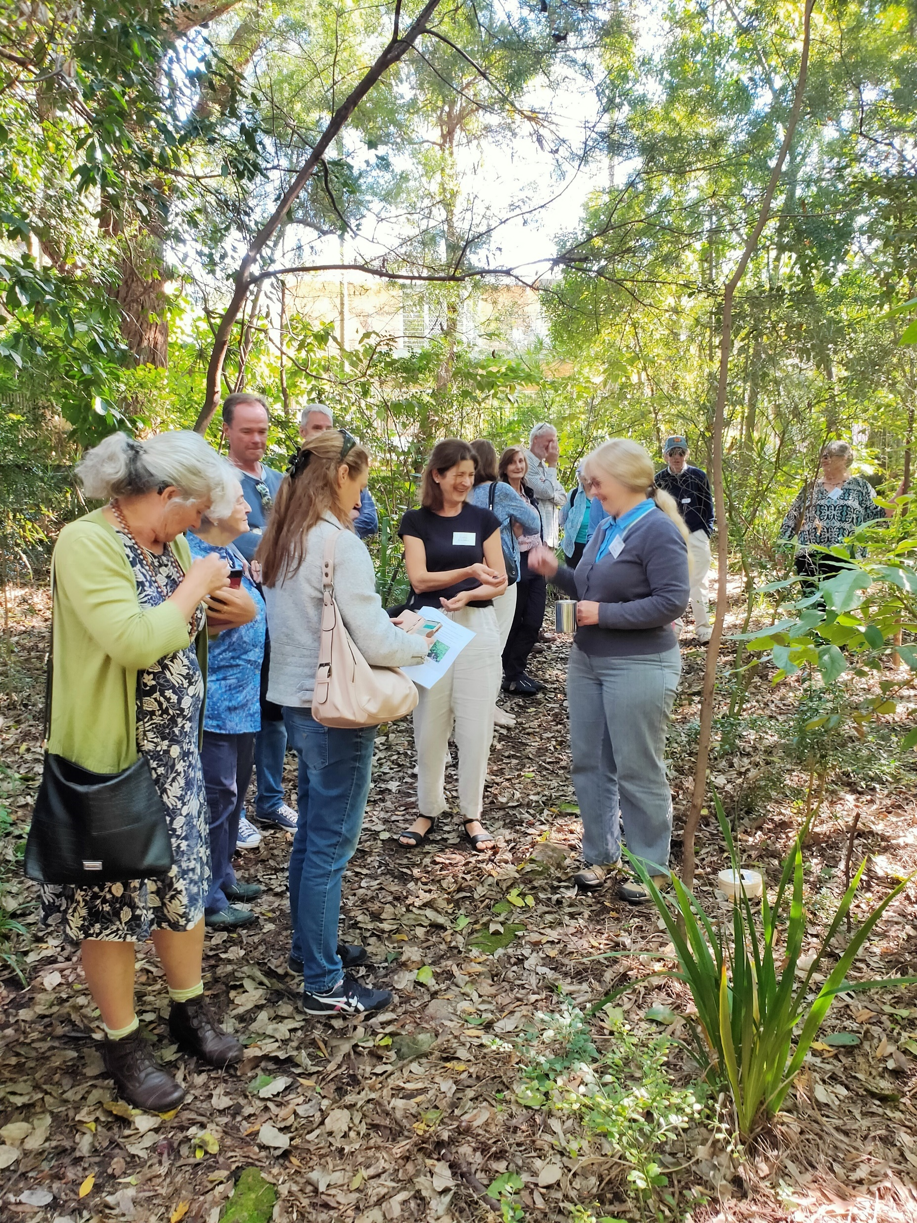
Sue Walters, Beverley Stacy (obscured), Jim Walters (behind), Sarah (nee Walters), Miriam Stacy, Jan Douglas
Dorothy Taylor & Jim.
Lloyd Hedges in background taking photo
Dorothy Taylor & Jim
Photos from Graham Fry

Slide 5
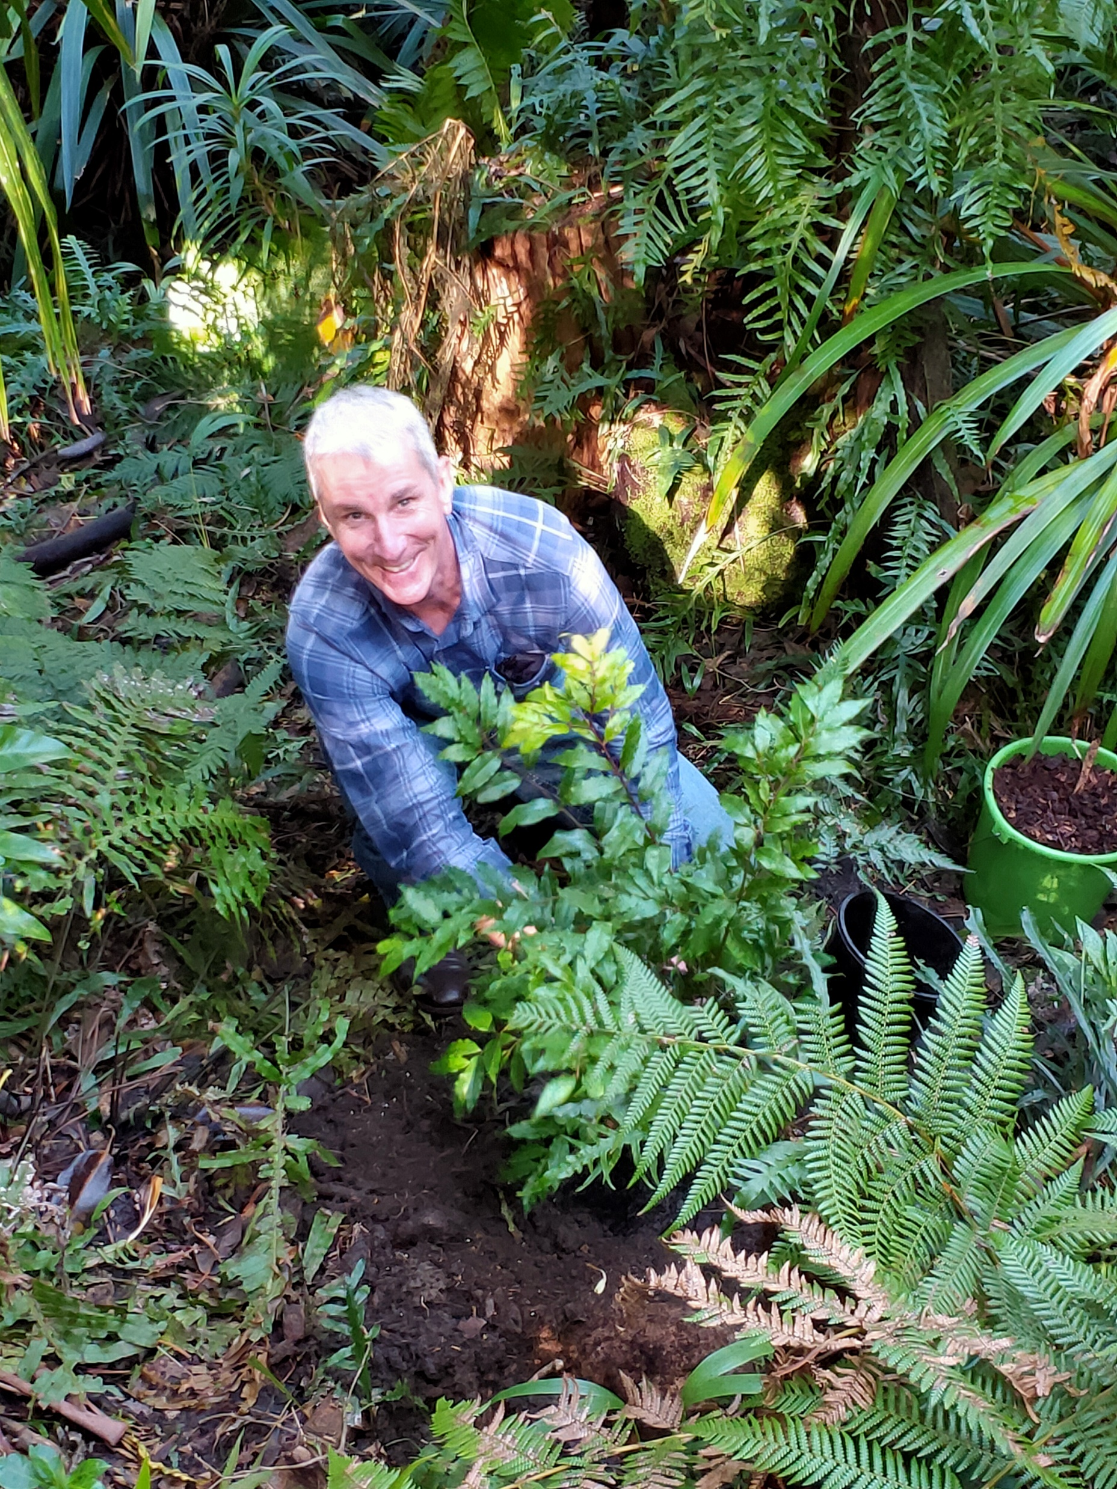
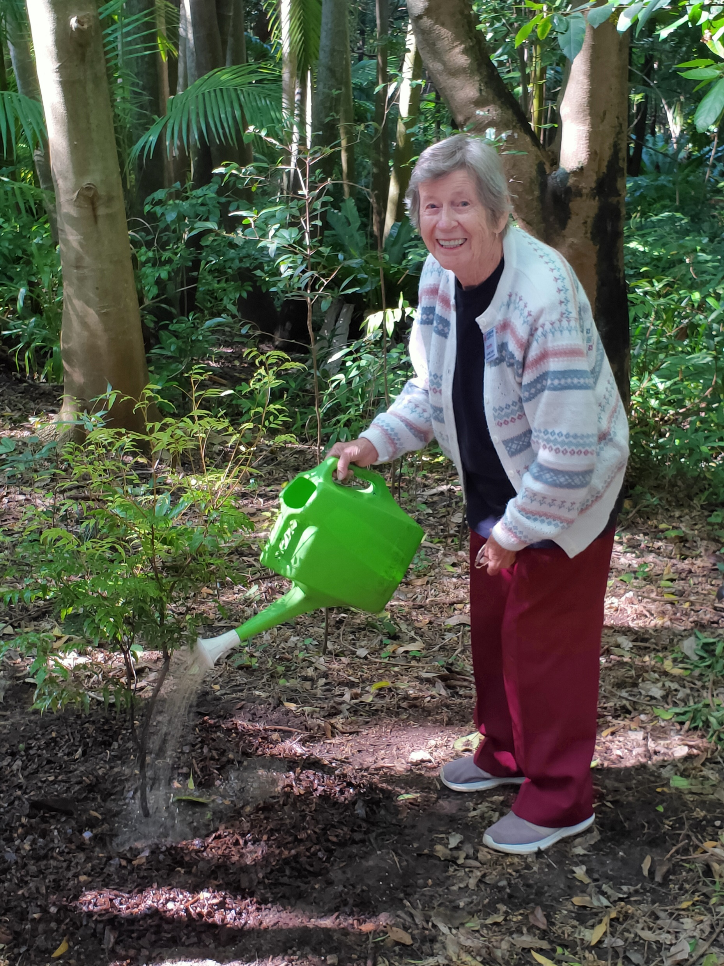
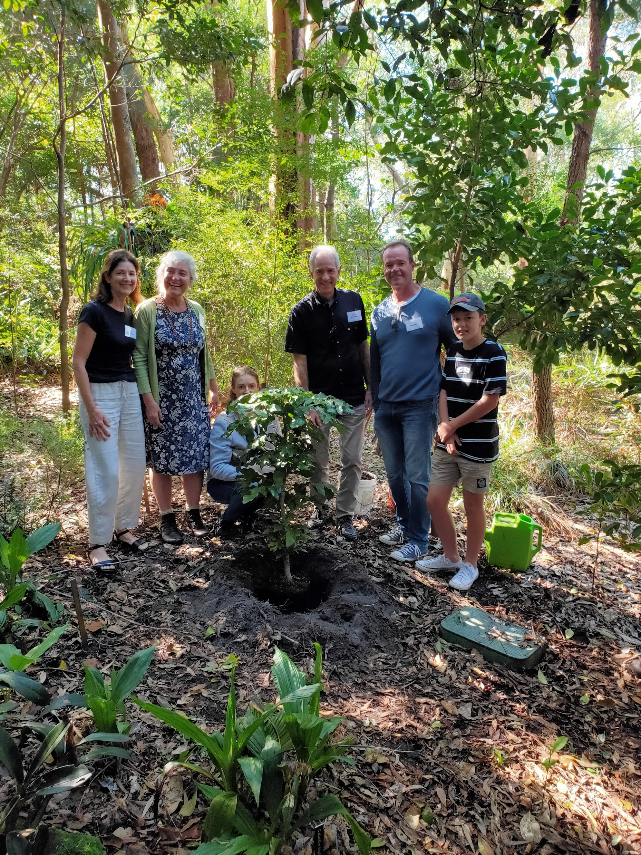
Jeremy Stacy
Walters Family
Dorothy Taylor
Photos from John Aitken

Slide 6
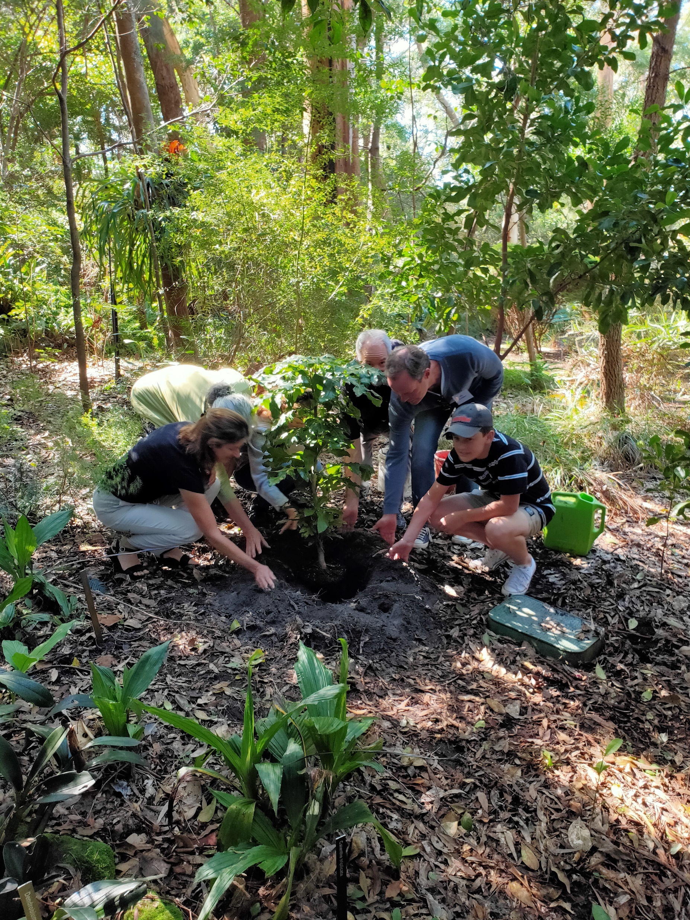
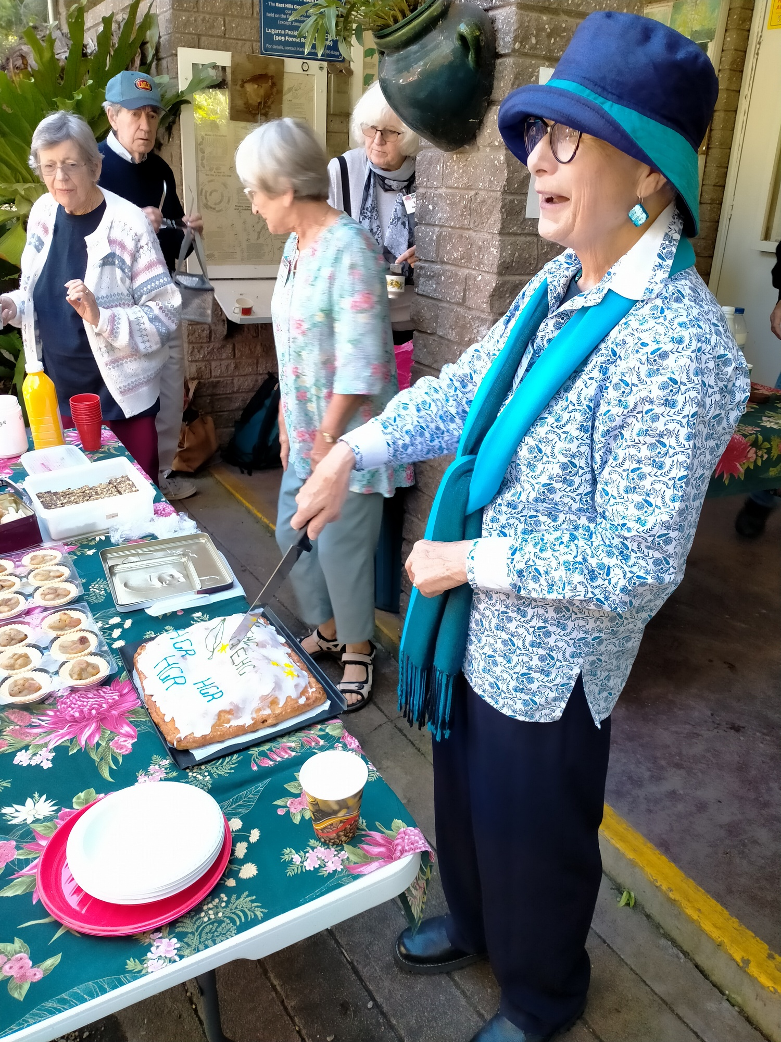
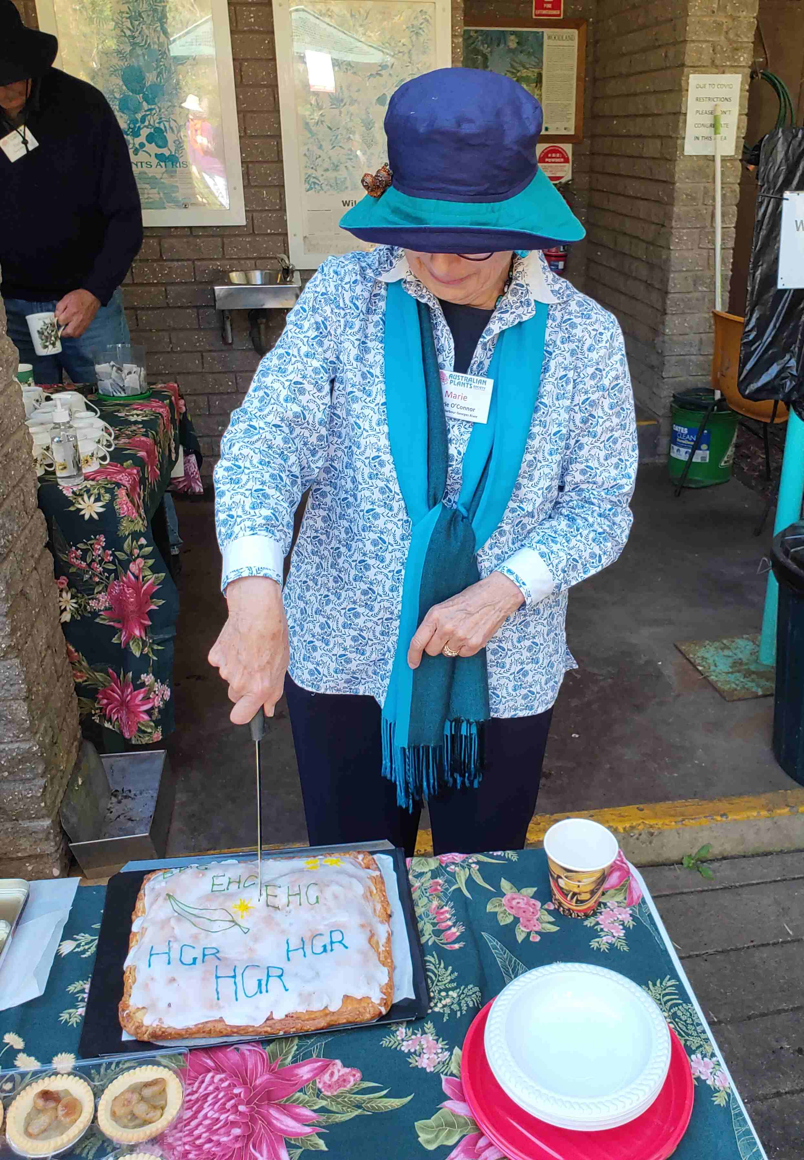
Walters Family
Photo from Graham?
Marie cutting cake
Dorothy, Tim Ball (from OFF), Liz, Kate Porritt
Photo from Graham
I like this one
Marie cutting cake
Photo from John
[cropped]
Note from Jan, who made it - according to the recipe, it was an apple slice rather than a cake. It was apple between two layers of pastry dough with icing on top. [apples from the country property]

Slide 7
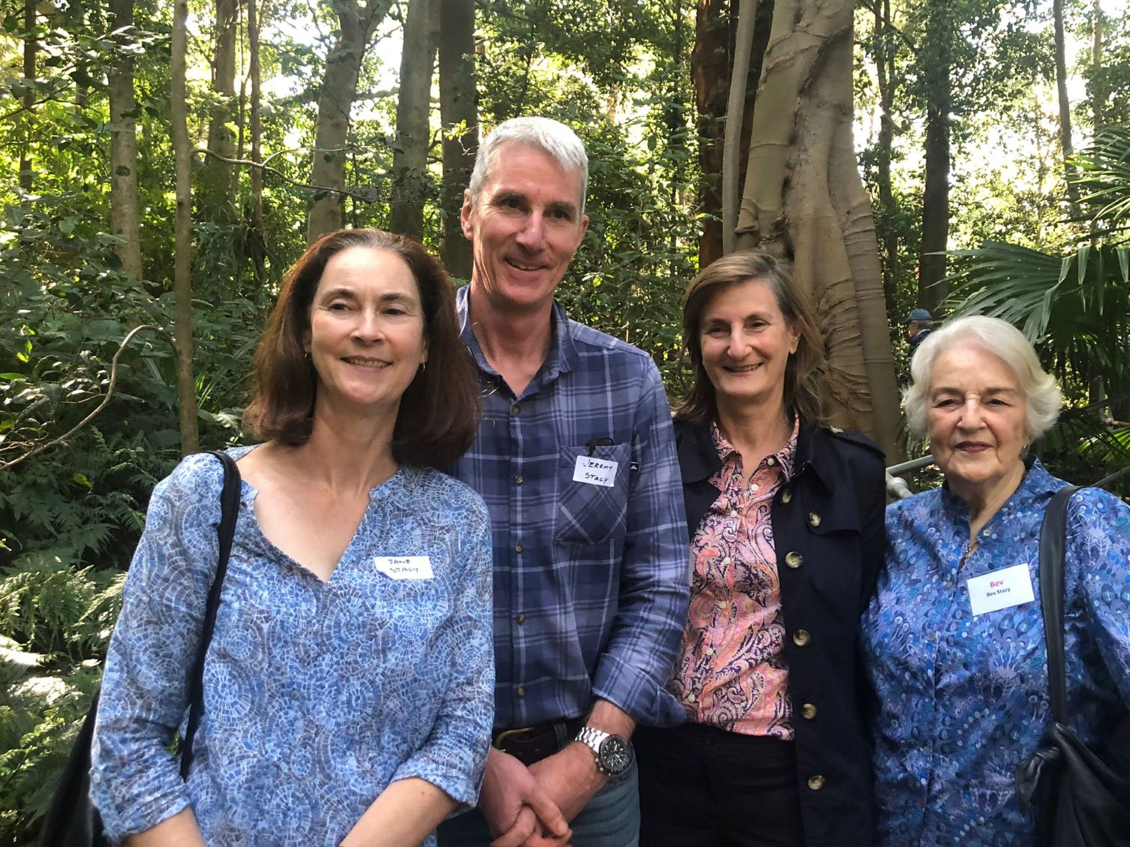
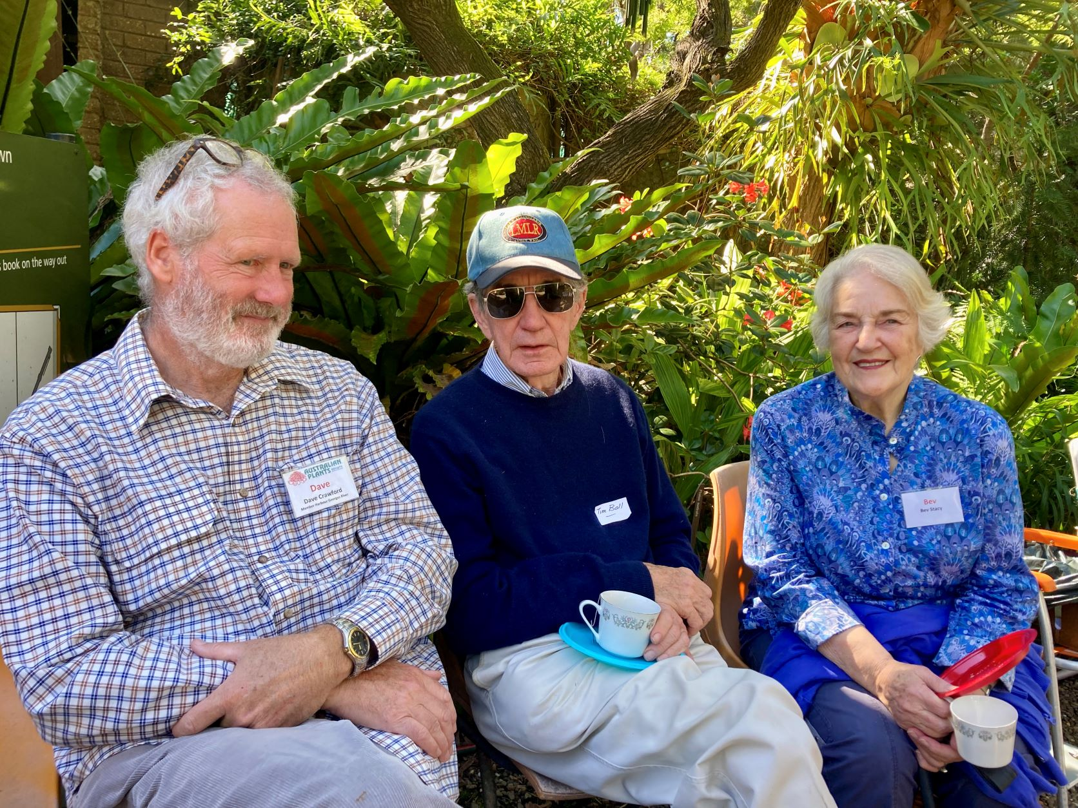
Sylvan Grove - Dave Crawford, Tim Ball (from OFF) and Bev Stacy
Jane, Jeremy, Miriam and Bev Stacy Cathy Wilkes photos

Slide 8
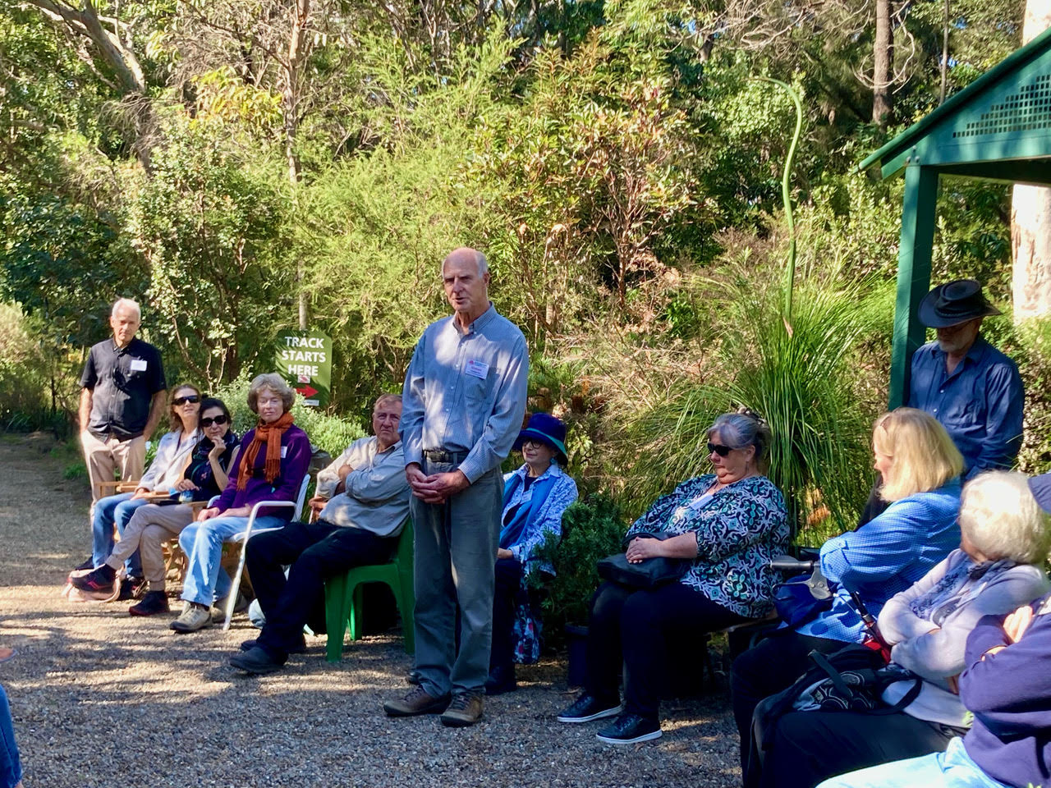
Sylvan Grove - Graham Fry paying tribute to Graham and Margaret Walters_20220504
Cathy Wilkes, one of the Walters family, provided these photos and wrote:
"It was such a beautiful morning at Sylvan Grove for the tree planting, please give our thanks to all the members. Thank you also for organising the lovely morning tea afterwards. Remembering Kyrill, Hugh and Mum & Dad in this way was a beautiful thing to do and I know our family really appreciated the thoughtfulness of you all in organising this."
Walters family Sylvan Grove_20220504

Slide 9
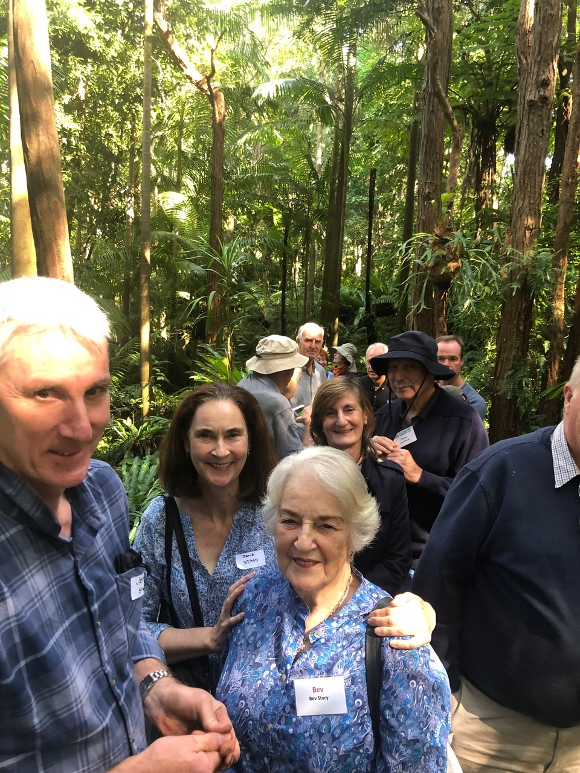
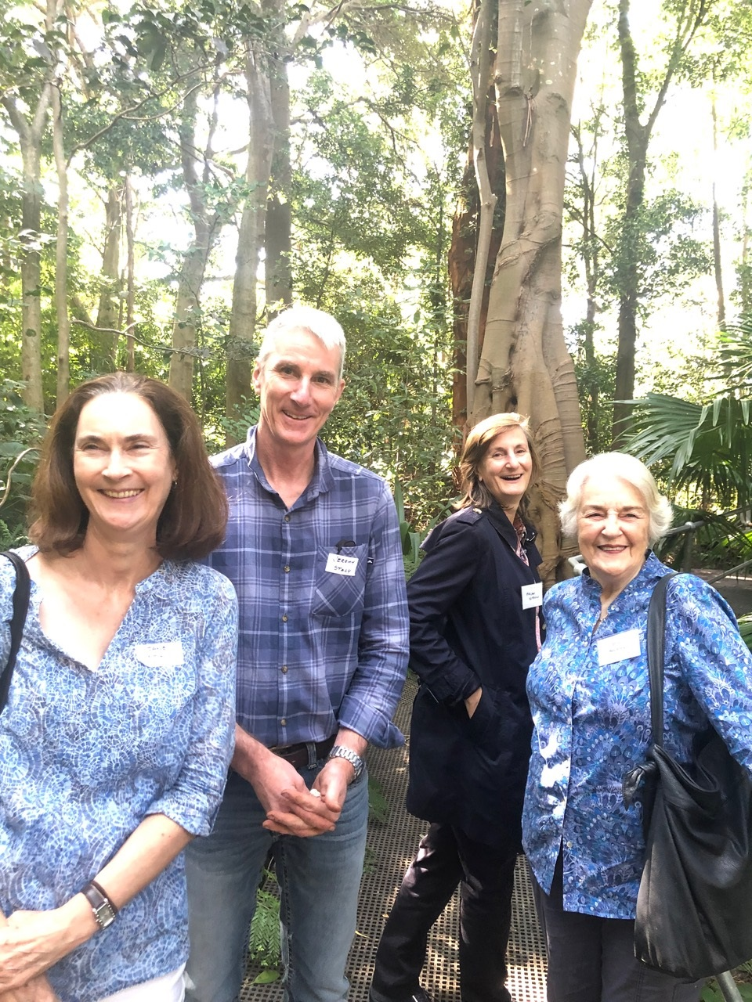
Group photo in the forest from Sue Walters showing the Stacy family
Photo from Sue Walters, Stacy Family - Jane, Jeremy, Miriam and Bev Stacy

